Slide 1
COSP230 Ch. 4
User Input, Variables, and Operations

Slide 2
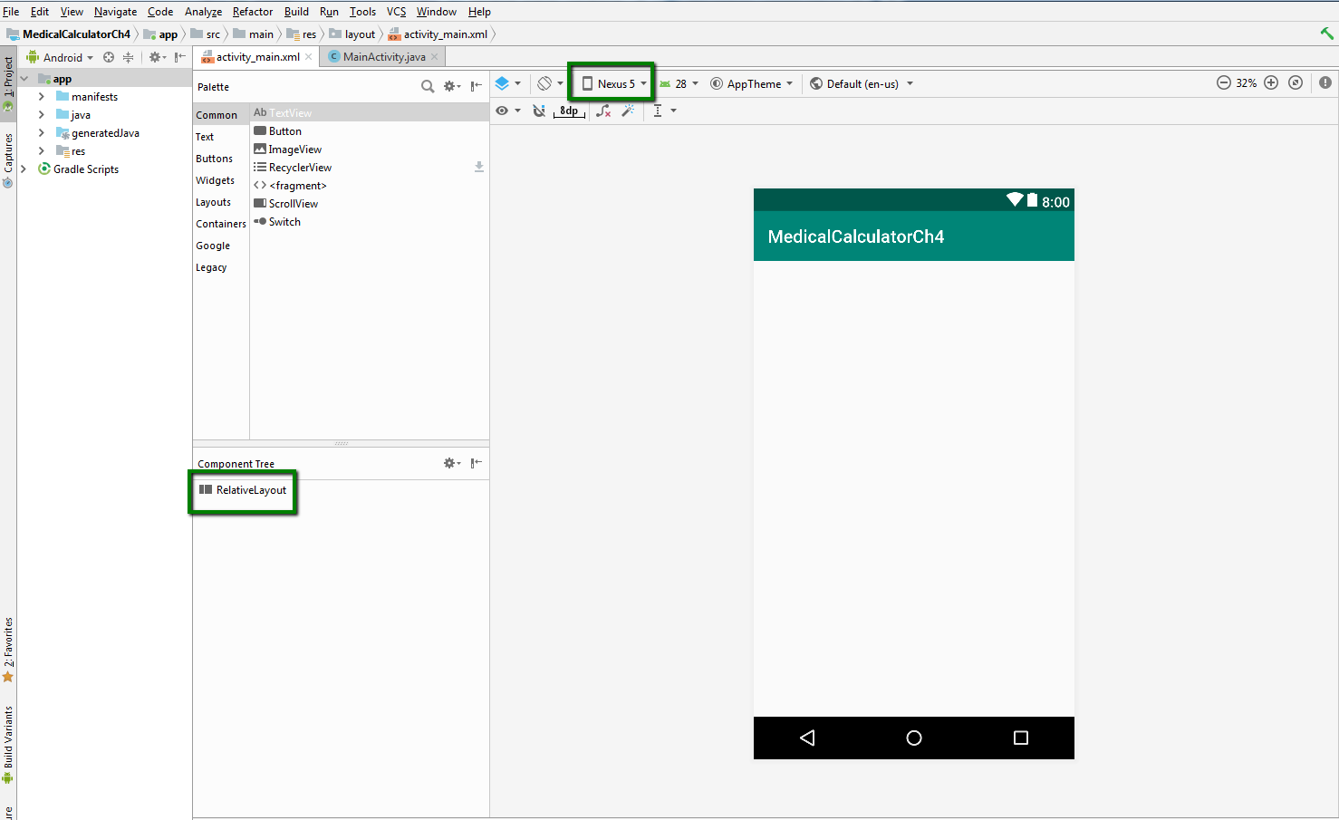
Start of Project (Delete HelloWorld text, select Nexus 5, convert to Relative Layout):

Slide 3
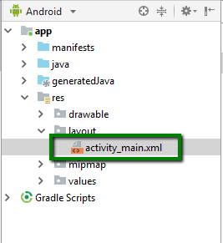
Prepare to add a Launcher Icon
Download the file ic_launcher_weight.png to your computer.
In the Android Project view, highlight the activity_main.xml file and right click on it.
In the menu bar, click the following sequence:
File->New->Image Asset

Slide 4
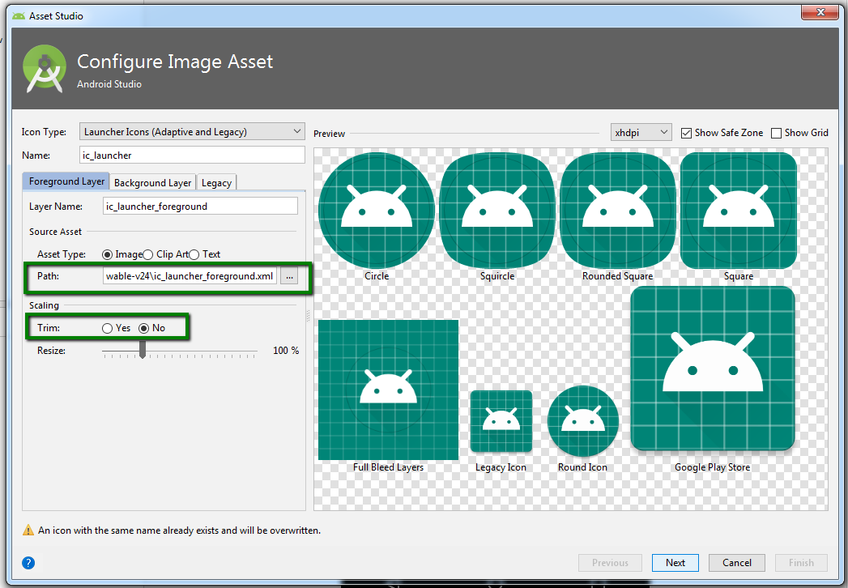
Configure Image Asset window
Will use Android icons by default
To add a custom icon, do the following:
Click the three dots next to the Path box.
Navigate to the location of the ic_launcher_weight.png file and select it. Then click OK.
Select Yes in the Trim area.
See next slide for what happens.

Slide 5
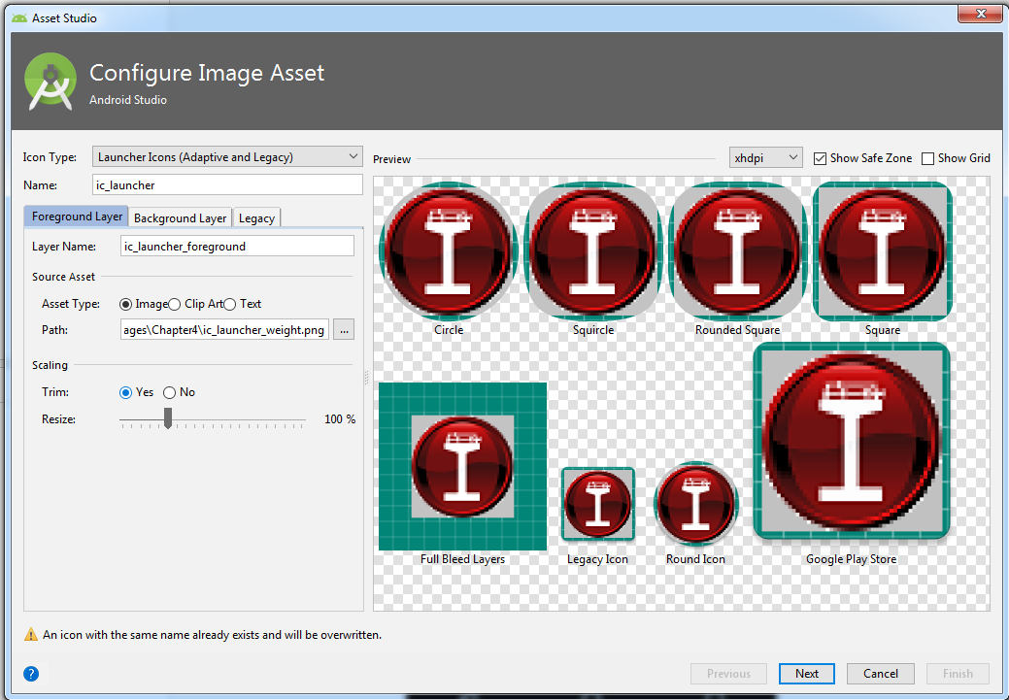
Window now looks like this. Click Next.

Slide 6
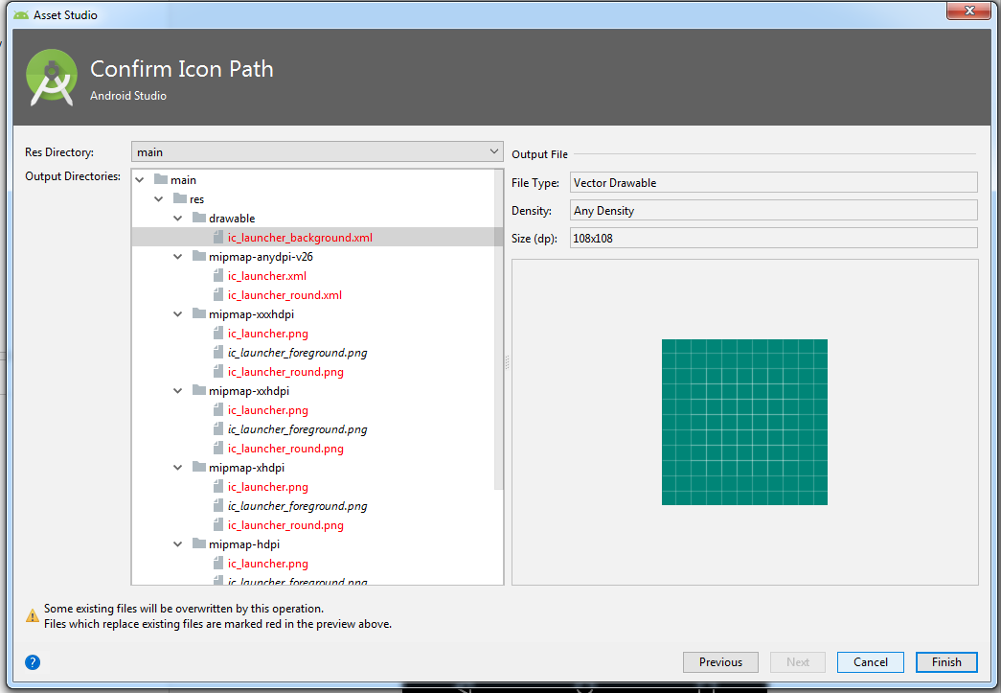
Mipmap folders
Different icons will be placed in different mipmap subfolders based on their size.
Click Finish.

Slide 7
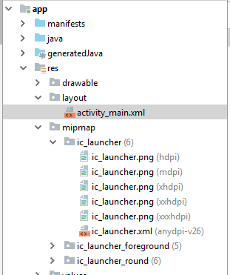
Mipmap folders (again)
When a custom icon is added by using Image Asset, it is renamed ic_launcher.jpg, regardless of previous file name.

Slide 8
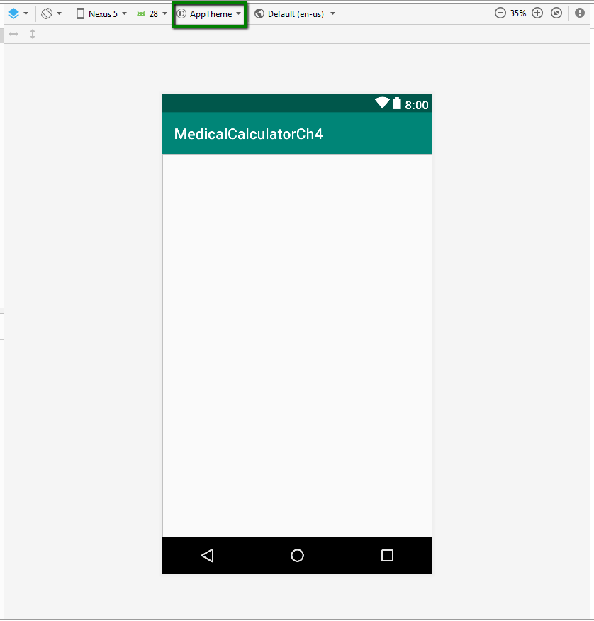
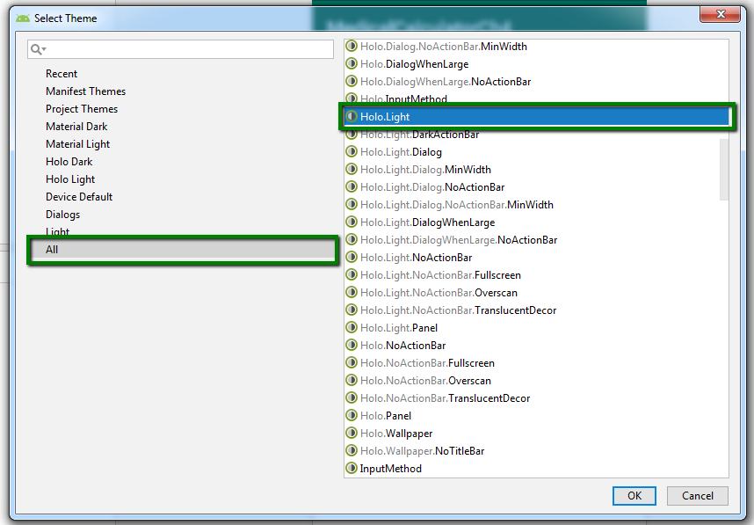
Change theme to Holo.Light

Slide 9
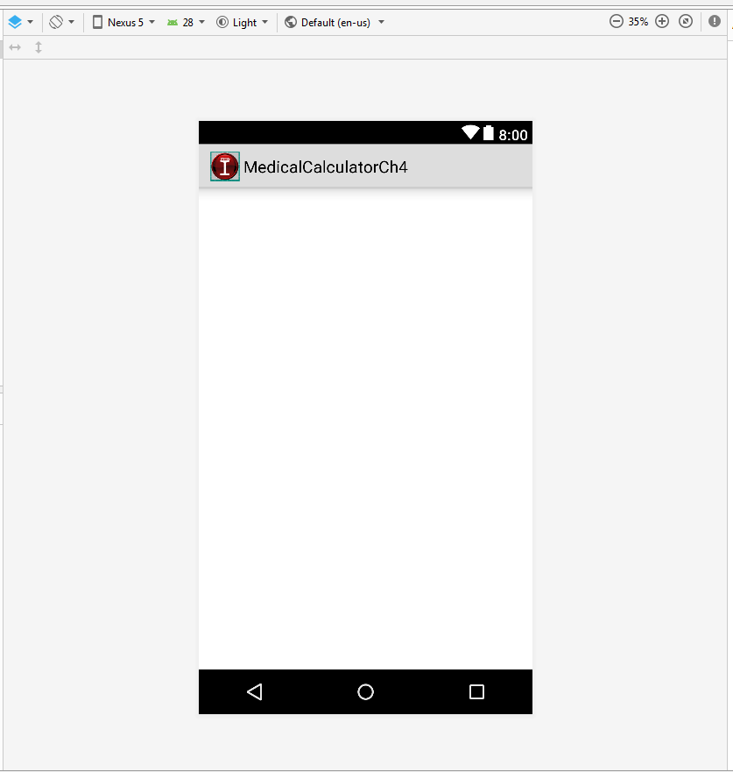
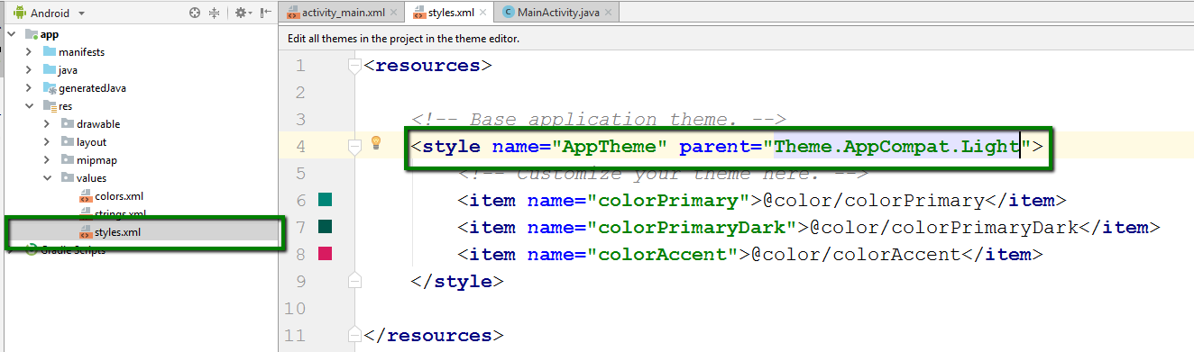
Change styles.xml to “Theme.AppCompat.Light”

Slide 10
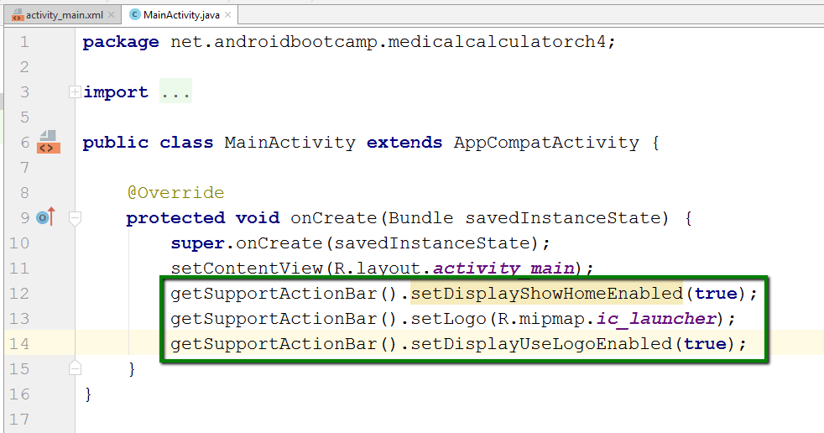
Add Java code to make logo in ActionBar permanent
Without adding Java code, the icon in the ActionBar is only a preview and will not appear when app runs.
Add the lines of code in the green box to the onCreate method in the MainActivity.java file.

Slide 11
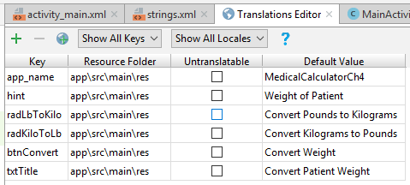
Add keys in Translations Editor
Open the Translations Editor
Add the keys in the table on the right:

Slide 12
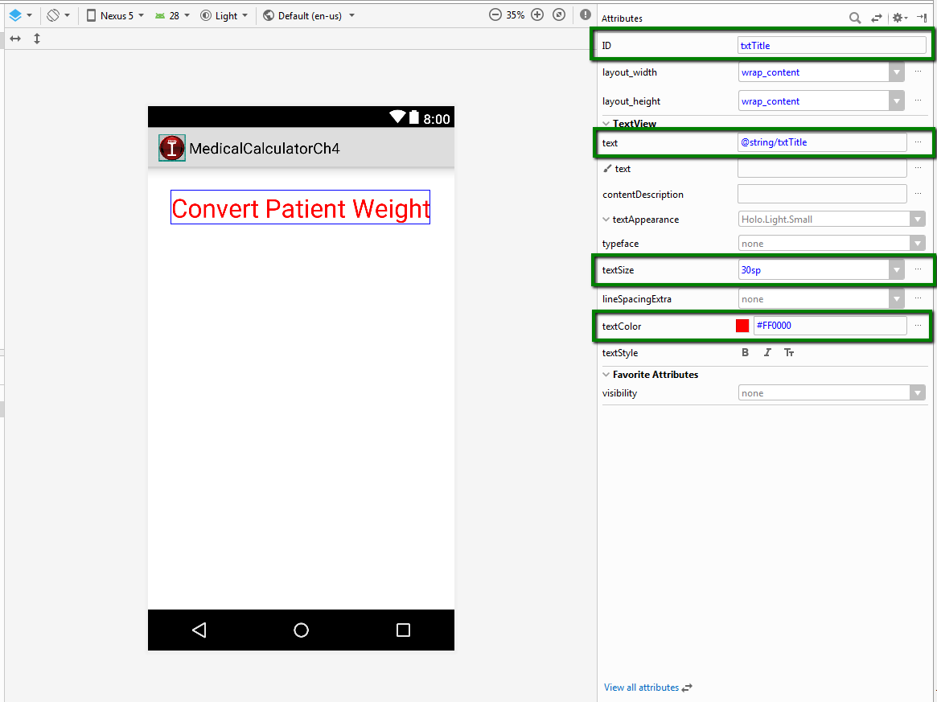
Add a Text View widget
Drag and drop a Text View widget into the emulator
Change values of the attributes in the boxes in the picture on the right.
But there’s one more…

Slide 13
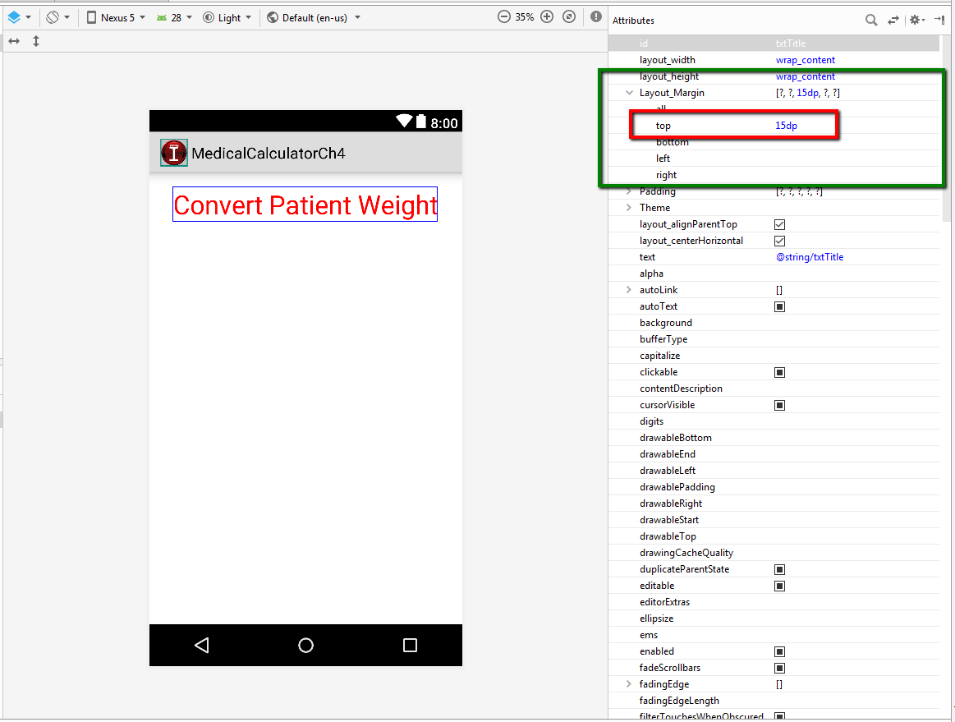
Change the Layout_Margin attribute
Can be used to set margins on all sides of a widget whatever sides you want.
Set Top margin to 15dp

Slide 14
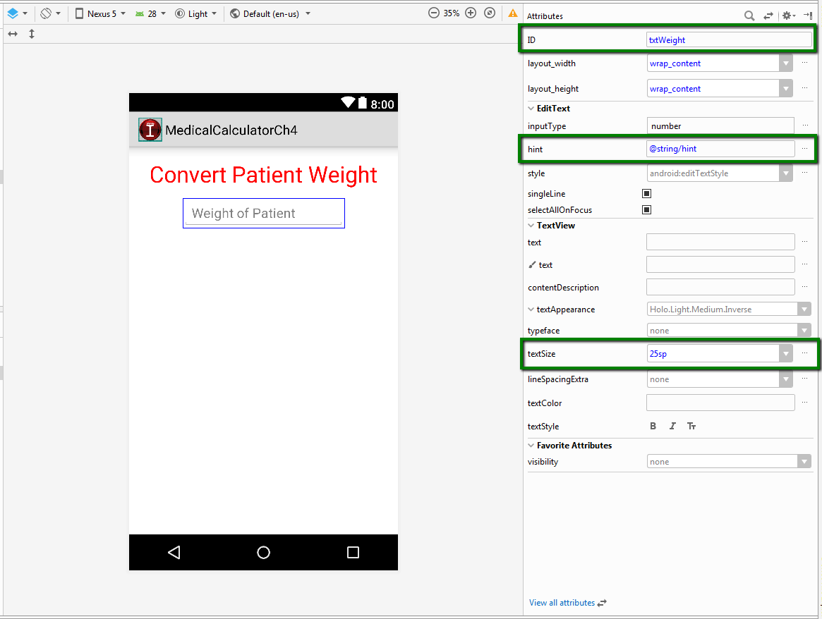
Add Number Text Field control
Drag and drop a Number control onto the emulator
Change attribute values in boxes in picture on the right.
But there’s more…

Slide 15
Change gravity attribute
Determines position of text for hint inside the Number Text Field
Select center_horizontal

Slide 16
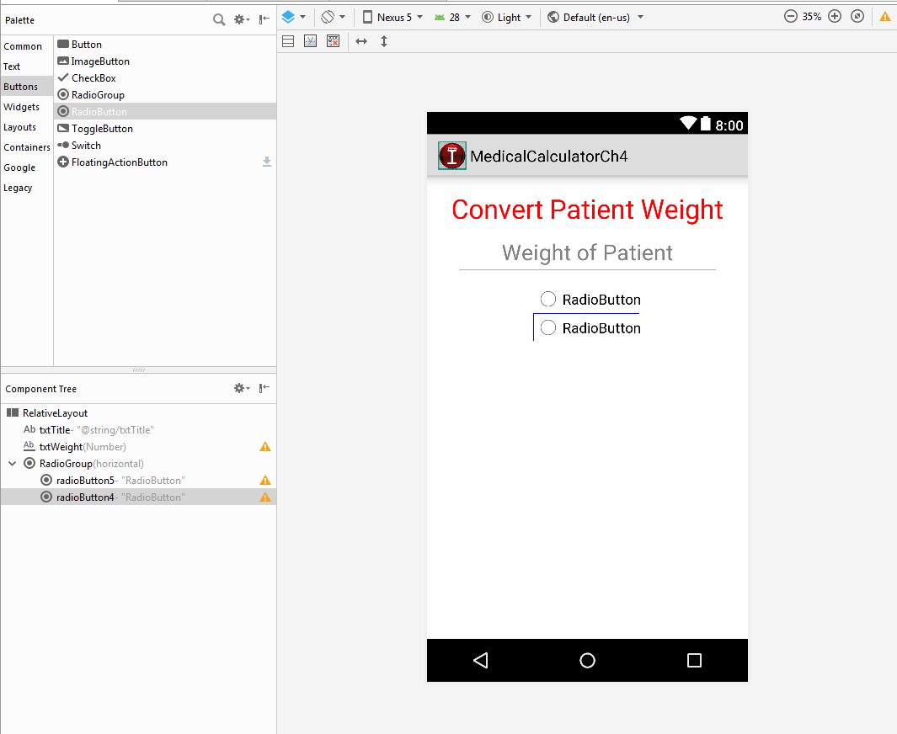
Add RadioGroup and RadioButtons
Drag and drop a RadioGroup on to the emulator
Drag and Drop two radio buttons below the RadioGroup in the Component Tree
DO NOT drag and drop the Radio Buttons onto the emulator.

Slide 17
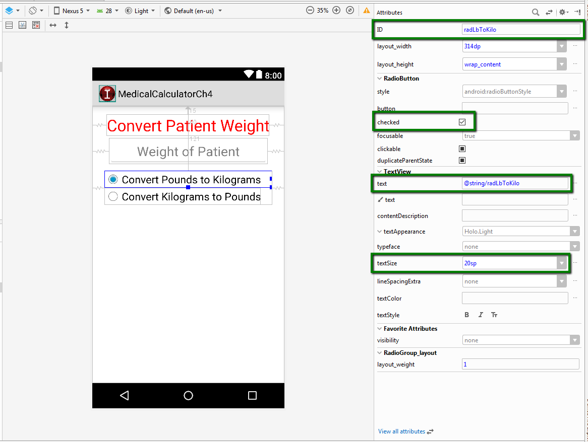
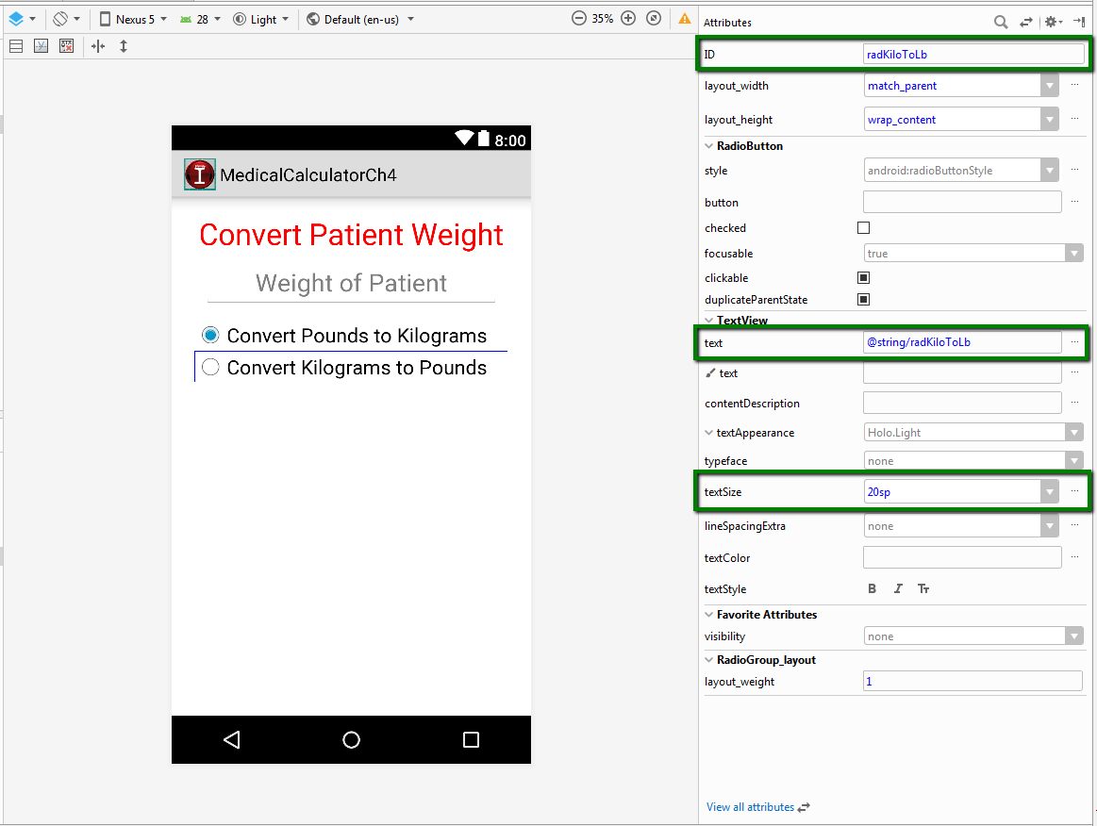
Change attributes of each radio button as shown below:

Slide 18
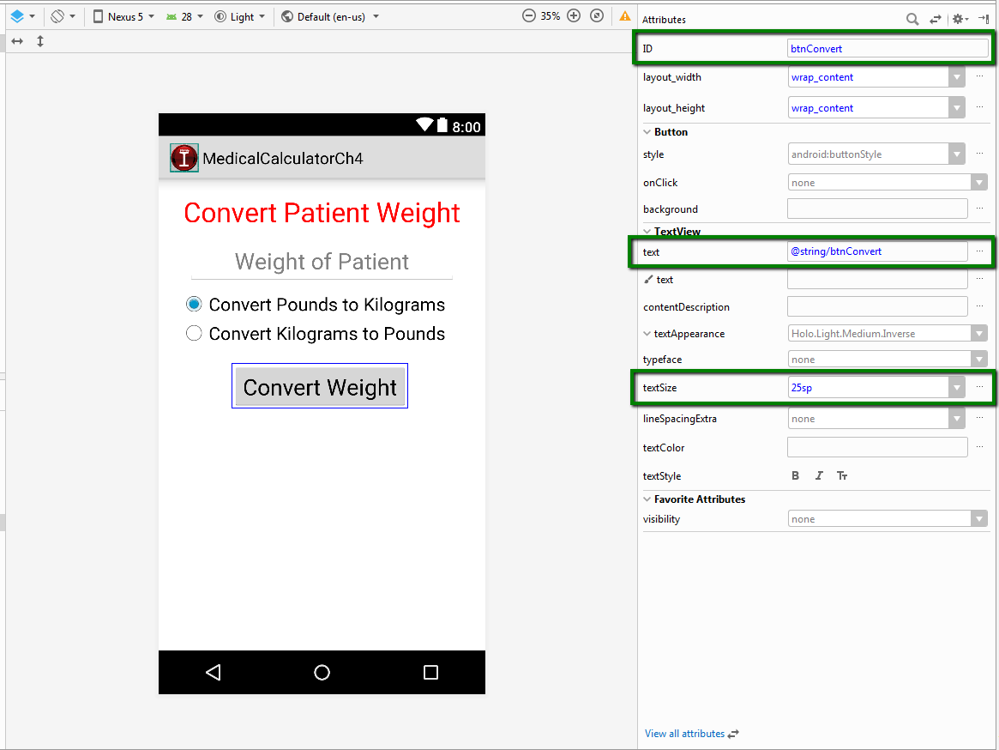
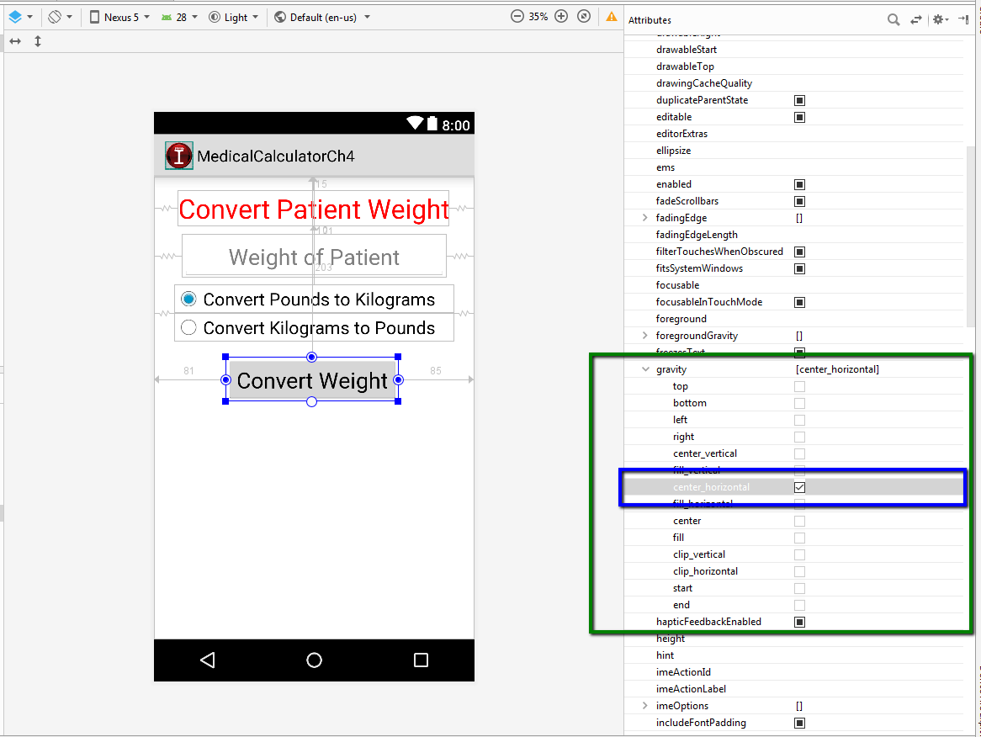
Add a button

Slide 19
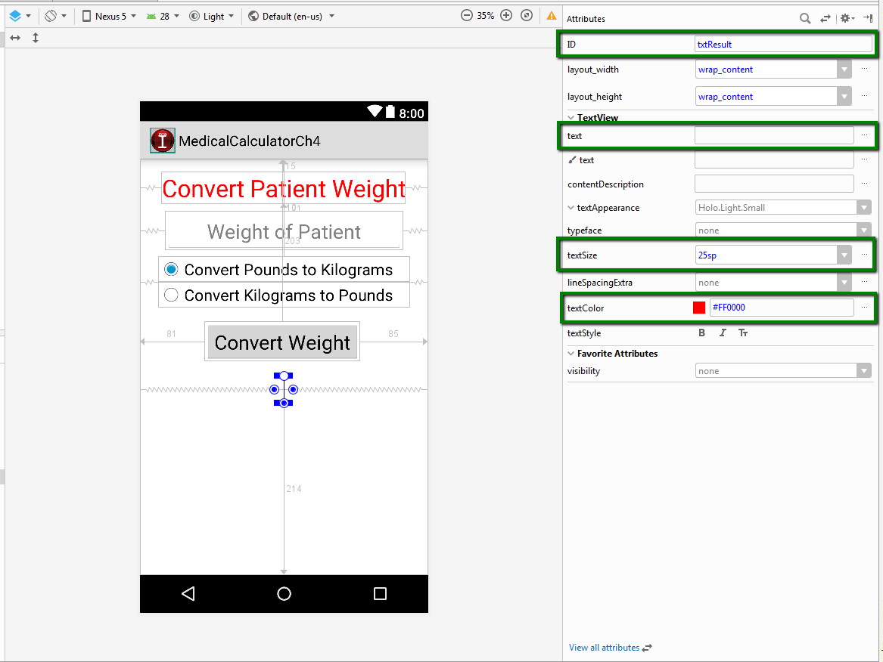
Add a Text View

Slide 20
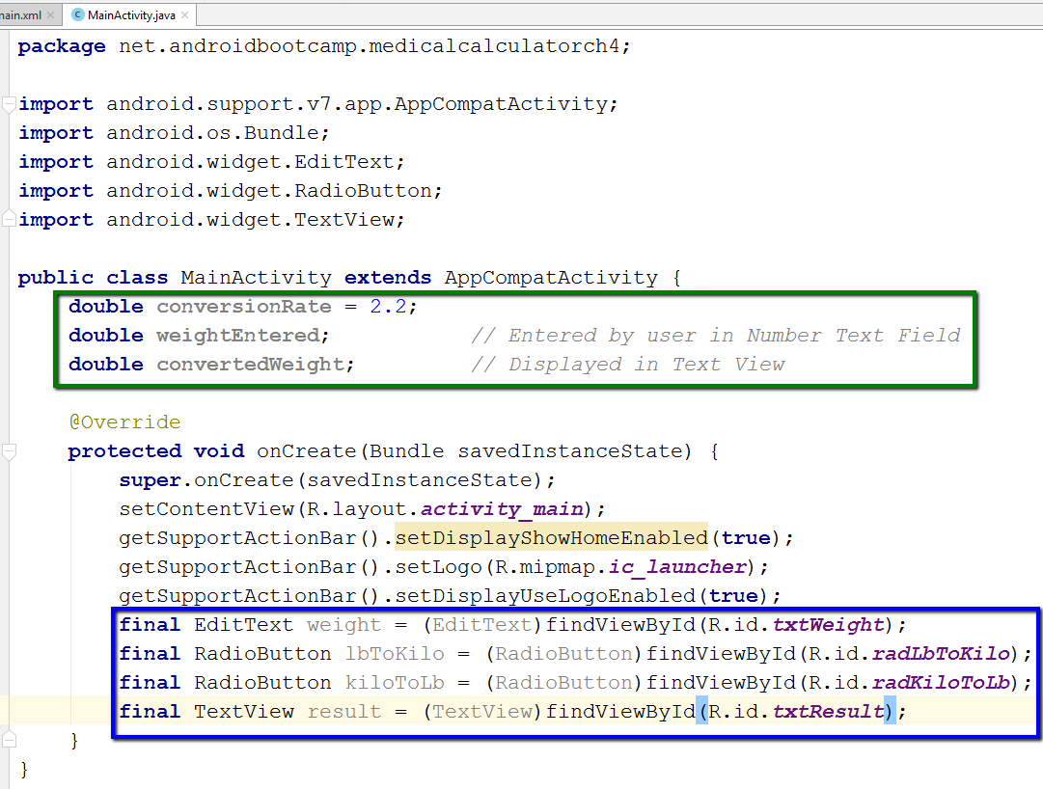
Add the following code to MainActivity.java:

Slide 21
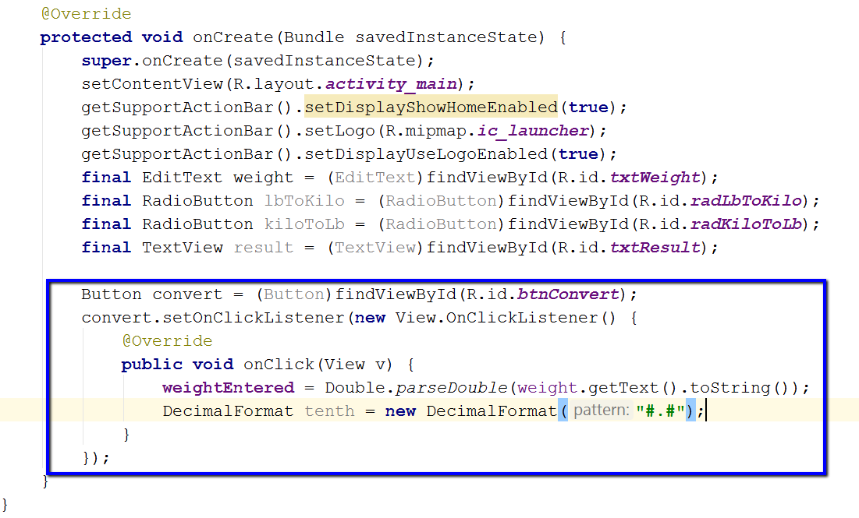
Now add the code in the box (some will appear automatically):

Slide 22
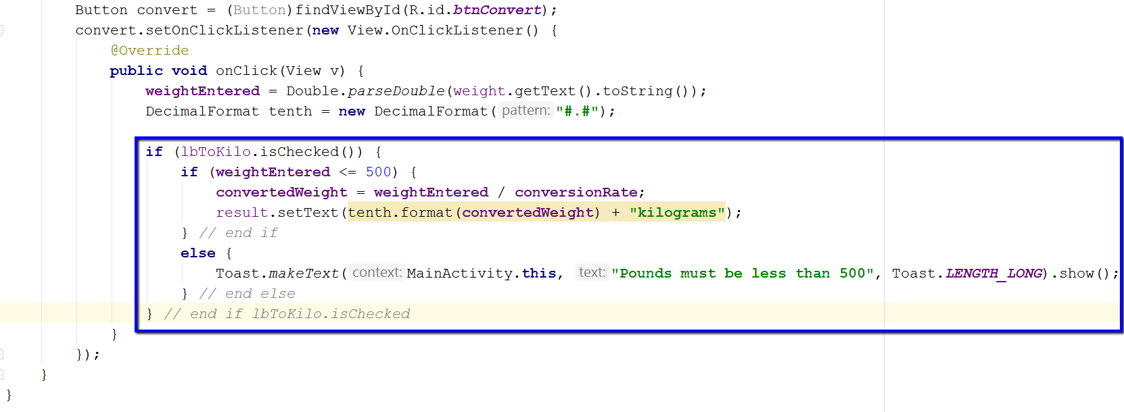
Add if-else statements and Toast notification
If-else statements make decisions
isChecked() returns TRUE if radio button is checked
Toast acts like a pop-up
Fades in and out automatically
Needs three parameters:
Context
Text message
Duration (LENGTH_LONG or LENGTH_SHORT)

Slide 23
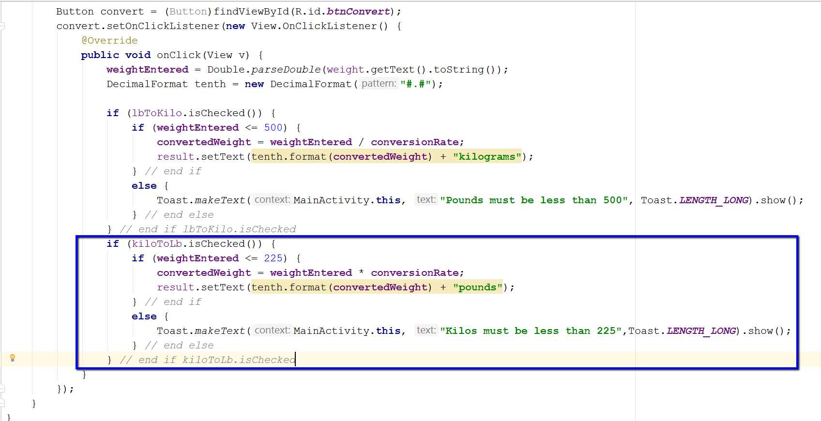
Add the code in the box

Slide 24
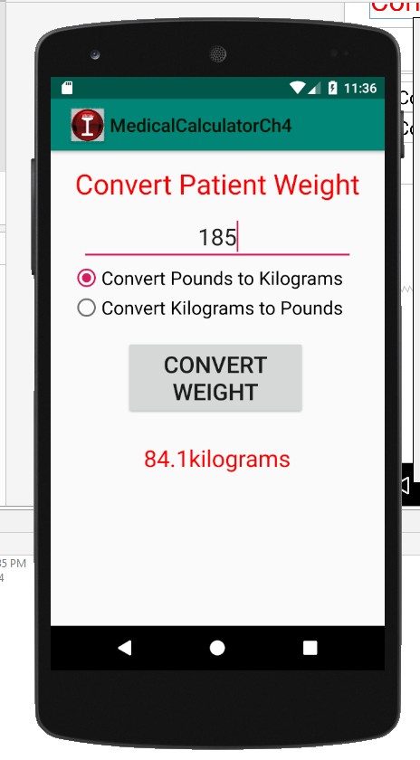
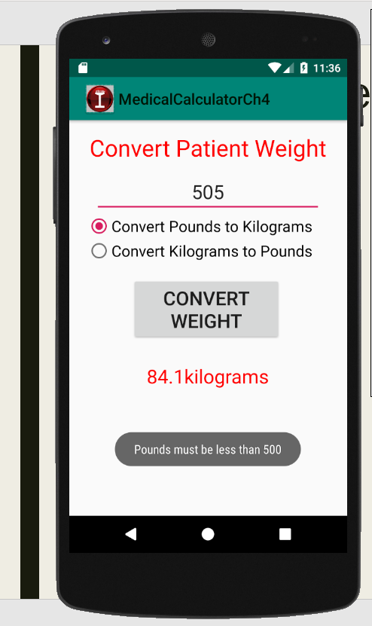
Output Samples

Slide 25
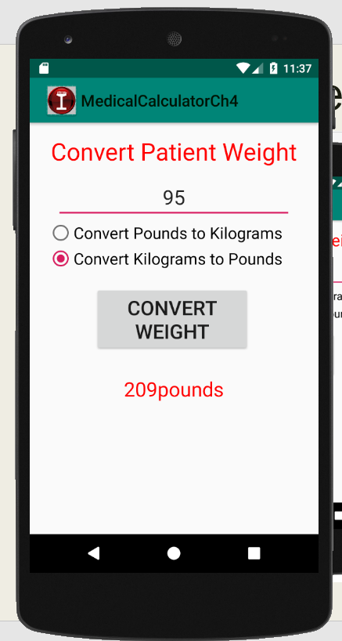
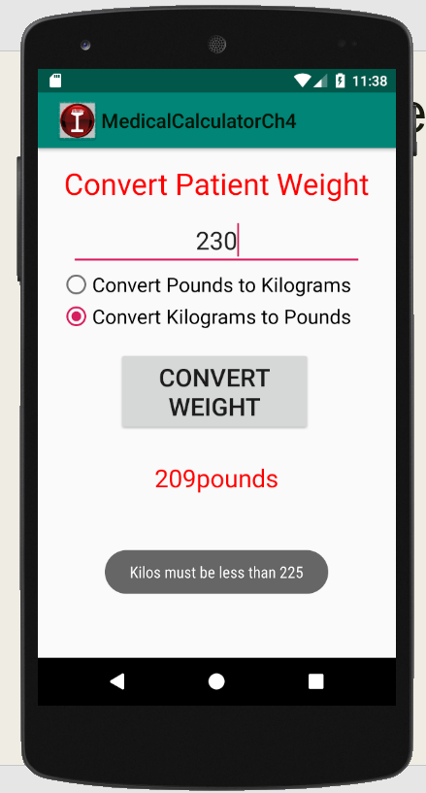
Output Samples

